Slide 1
Chapter 0
Introduction - Review

Slide 2


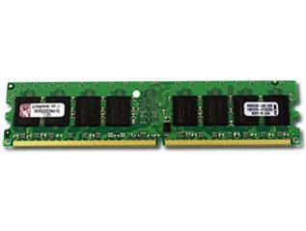
What we’ll cover this semester
TM
PDA
DFA
NFA
Mathematical models of computation
Decidability theory
(What can be computed, i.e., decided, by models)
Complexity Theory
(Resources required so that problems can be computed)

Slide 3




Review – Mathematical Models
Sets
S = { blue, red, yellow, green }
Set
Elements (or members)
A = { blue, red }
$$A ⊆S$$
A = {1, 2, 3, ….} or A = { n | n $∈ ℕ$ }
$$S ⊆S$$
$$A ⊊S$$
Subsets
Proper subset
Infinite set
B = { }
B = { white }
B = { red, blue }
Empty set
Singleton set
Unordered pair

Slide 4



Review – Mathematical Models
Sets
Order and repetition of elements does not matter
{ 1,2,3 } = { 1,1, 3, 2 }
$$\left|\left\{ 1, 2, 3 \right\}\right|=3$$
$$\left|\left\{ 1, 1, 2, 3 \right\}\right|=3$$
$$\left| \left\{\right\} \right|=0$$
{ 1, 2, 3 } ≠ { 1, 1, 2 }
$$x ∈A then x ∈ B (and vice versa)$$
Equivalent Sets
Cardinality
A = $\{0, 1\}$
$$\left(A\right)=\{ ∅, \left\{0\right\}, \left\{1\right\}, \left\{ 0, 1 \right\} \}$$
\$$(A)|= 2^{|A|}
Power Set

Slide 5



Review – Mathematical Models
Venn Diagrams
$$A ∪ B$$
$$A ∩ B$$
$$\overline{A ∩ B }$$
Union
Intersection
Complement

Slide 6
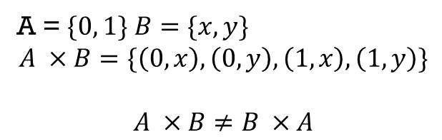

Review – Mathematical Models
Sequences and Tuples
$$\left(a_{1},a_{2}, …a_{k}\right)$$
(1,2,3) ≠(1,1,2,3)
Order and repetition of elements do matter
|(1,2,3)| = 3
(1,2,3) ≠ (1, 3, 2)
|(1,1,2,3)| = 4
K-tuple (Ordered pair if k = 2)
Cardinality
A = $\{0, 1\}$ $B=\{x, y\}$
$$A ×B=\{\left(0,x\right), \left(0,y\right), \left(1,x\right), \left(1,y\right)\}$$
$$A ×B≠B ×A$$
Cross (or Cartesian) Product

Slide 7
Review – Mathematical Models
Function and Relations
A function f is a mapping, which sets up an input-output relationship, assigns an input element to a unique output element
f: D → R
where D is the domain of f, and
R is the range of f
Example. Addition is a function, e.g., Add(2, 3) = 5, such that the domain is a set of ordered pairs, and the range is a set of numerical values.
Example. f(A) = { b ∈ B | b = f(a) for some a ∈ A}

Slide 8
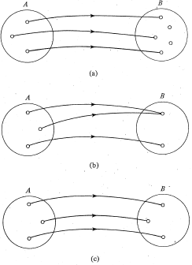
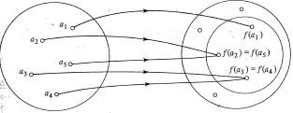
Review – Mathematical Models
Function and Relations
Injection
Surjection
Bijection
A function f

Slide 9
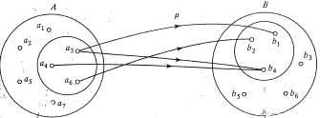
Review – Mathematical Models
Function and Relations
A subset of the Cartesian product A₁ × A₂ ×... × A_{n} is called an n-ary relation over A₁, A₂, ..., A_{n}
A special case is n = 2, i.e., a set of (ordered) pairs, in which the 1st coordinate is from A₁ and the second from A₂, and is called binary relation from A₁ to A₂

Slide 10
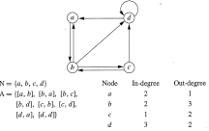
Review – Mathematical Models
Graphs
An undirected graph, or simply a graph, is a set of nodes (or vertices) with lines connecting some of the nodes
A directed graph has arrows instead of lines without arrows
A subgraph G of a graph H consists of a subset of the nodes in H, and the edges of G are the edges of H on the corresponding nodes

Slide 11








Strings
An alphabet is a set of symbols
Examples
A string is a finite sequence of symbols over an alphabet
Examples
$$Σ_{1}=\{0 ,1\}$$
$$Σ_{2}=\{a,b,c,d,e,f,g,h,…, z\}$$
$$\left(0,0\right), \left(1,0,1\right), \left(1,1\right)….$$
$$\left(h,i\right), \left(h,e,l,l,o\right), …$$
$$00, 101, 11,…$$
$$hi, hello,…$$
Strings over $Σ_{1}$
Strings over $Σ_{2}$
Simplifications

Slide 12
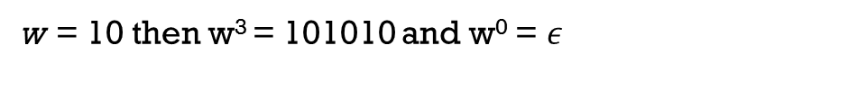

Strings
More info on strings
Length (number of symbols in a string)
Empty string (string of length zero)
Concatenation (association of strings)
Repetition (w^{i})
w = 101 then |w| = 3
$$ε$$
x = 101, y = 00 then xy =10100
w = 10 then w³ = 101010 and w⁰ = $ε$

Slide 13
Strings
More info on strings
Reverse (w^{R})
Substring(string that appears consecutively within another string)
w = w₁w₂…w_{n} then w^{R} = w_{n} w_{n-1} … w₁
w = abc then w^{R} = cba
w = w^{R} then w is a palindrome
w = abracadabra
y = dab
y is a substring of w

Slide 14

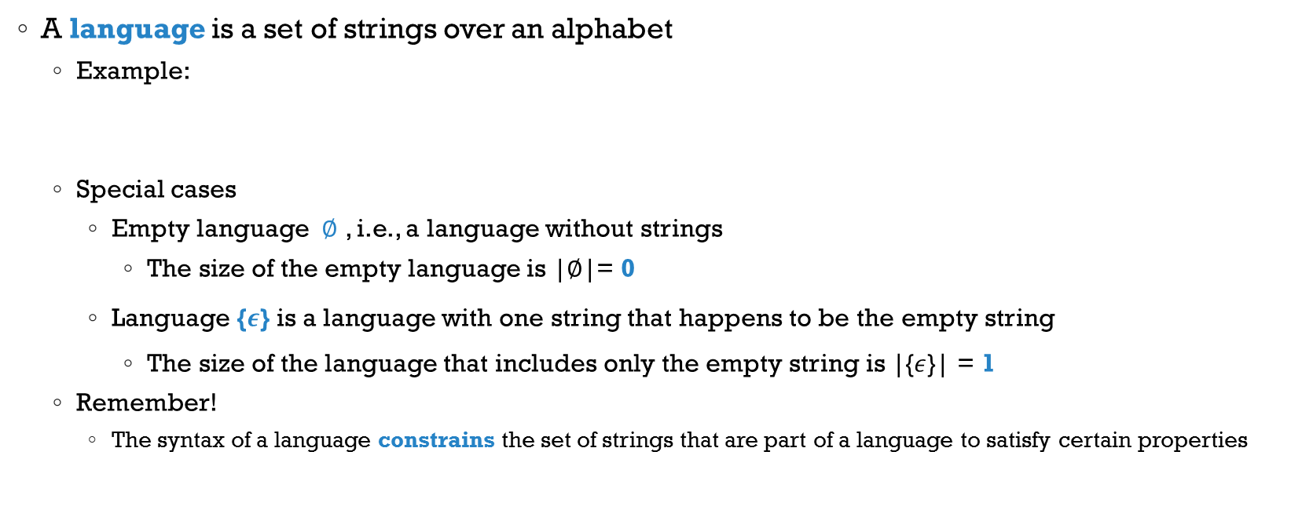



Languages
A language is a set of strings over an alphabet
Example:
Special cases
Empty language $∅$ , i.e., a language without strings
The size of the empty language is |$∅$|= 0
Language {$ε$} is a language with one string that happens to be the empty string
The size of the language that includes only the empty string is |{$ε$}| = 1
Remember!
The syntax of a language constrains the set of strings that are part of a language to satisfy certain properties
$$\{00 ,11, 0011\}$$
Languages over $Σ$
$$Σ=\{0 ,1\}$$
$$\{01 ,10, 1001\}$$

Slide 15
Languages
We define a language by
Listing all strings
{01,0011,000111,...}
Describing how to construct a typical string
{0^{k}1^{k}|k > 0}
Describing how to test a string for membership
{x over {0,1}| x has the same number of 0’s and 1’s, has at least one 0, and all 0’s precede all 1’s }
Defining a machine/program that accepts all strings in a language
Defining an expression/set notation that describes all strings in a language

Slide 16
So Far….
Review on sets and sequences
General overview of languages
Symbols
Alphabet
String
Language

Slide 17
Definitions, Theorems, and Proofs
Statement: an unambiguous, precise description of some property that an object has.
A statement may be true or not
Theorem: a statement that has been proved to be true
Proof: a convincing logical argument that a statement is true i.e., holds

Slide 18





How to work out a proof
Understand a statement and all its parts
Is the statement is true or false? Try a few examples. Find a counterexample
Can a proof be adapted to a new theorem? Explore differences, what is missing, what is not needed?
Create an outline of the proof. E.g., First I need to show this, after that I need to show that, etc.
If you get stuck, try to prove an simpliﬁed statement or a special case of it. Try diﬀerent proof method
If you get frustrated switch to something else, take a step back
Ensure that other people reading your proof (and yourself) can follow your statements

Slide 19
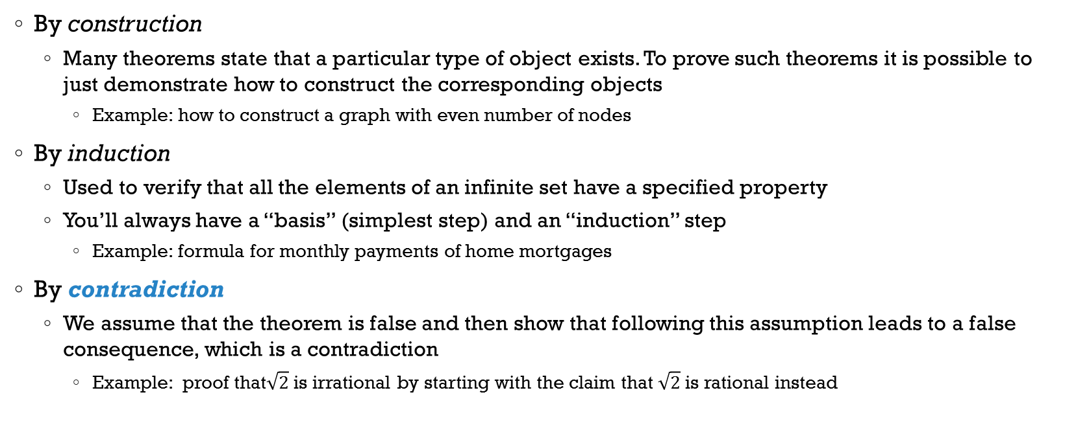
Types of Proofs
By construction
Many theorems state that a particular type of object exists. To prove such theorems it is possible to just demonstrate how to construct the corresponding objects
Example: how to construct a graph with even number of nodes
By induction
Used to verify that all the elements of an infinite set have a specified property
You’ll always have a “basis” (simplest step) and an “induction” step
Example: formula for monthly payments of home mortgages
By contradiction
We assume that the theorem is false and then show that following this assumption leads to a false consequence, which is a contradiction
Example: proof that$\sqrt{2}$ is irrational by starting with the claim that $\sqrt{2}$ is rational instead

Slide 20

Examples – Whiteboard Work
For any two sets A and B, $\overline{A ∪B }= \overline{A} ∩ \overline{B}$
To prove this, we want to show that the two sets are equivalent. We do so by showing that every element in the first set is included in the second set, and vice versa

Slide 21
Examples – Whiteboard Work
Definition. Reversal, which is a unary operation, rewrites a string backward, is defined as
i) Basis: If length(u) = 0, then u = ε and ε^{R} = ε.
ii) Recursion: If length(u) = n (> 0), then u = wa for some string w with length n - 1 and some a ∈ Σ, and u^{R} = aw^{R}
Theorem. Let u, v ∈ Σ*. Then (uv)^{R} = v^{R}u^{R}.

